Slide 1

Demystifying AI and Machine Learning
A/Prof Richard Xu
UTS Faculty of Engineering & IT
14/Mar/2018

Slide 2
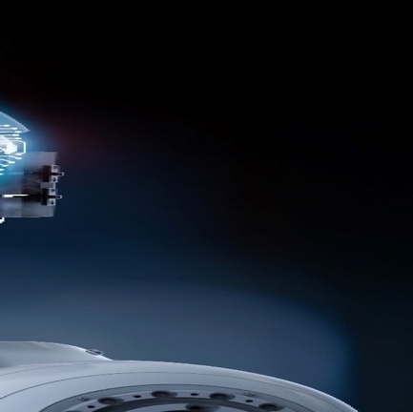
AI in a day.
UTS :: FEIT :: Richard Xu
08
Self-driving car
07
Finance security
Drunk and
go home
Pay
for dinner
06
Recommendation
system
01
Face recognition
Unlock
iPhone X
Choose
where to eat
Ask
Siri/Echo
Translation
02
Audio recognition
05
Nature Language
processing
Check
emails
Google map
navigation
03
Intelligence transports planning
04
Spam filtering

Slide 3
Applications of AI & ML – just from our lab’s industry’s engagement alone
UTS :: FEIT :: Richard Xu
Product range modelling
Smart city applications
Customer segmentation
CityRail Bus replacement optimization
Predictive inventory/maintenance
Injury prediction
Recommendation system
Peer-to-peer lending ranking
Personalized email/campaign
Process optimization
Product correlations
Education-to-job alignment
Transport passenger prediction
Real-time strategy for defense
HR performance indictor prediction
Network traffic modelling
Sentiment analysis
Chabot
…
…

Slide 4
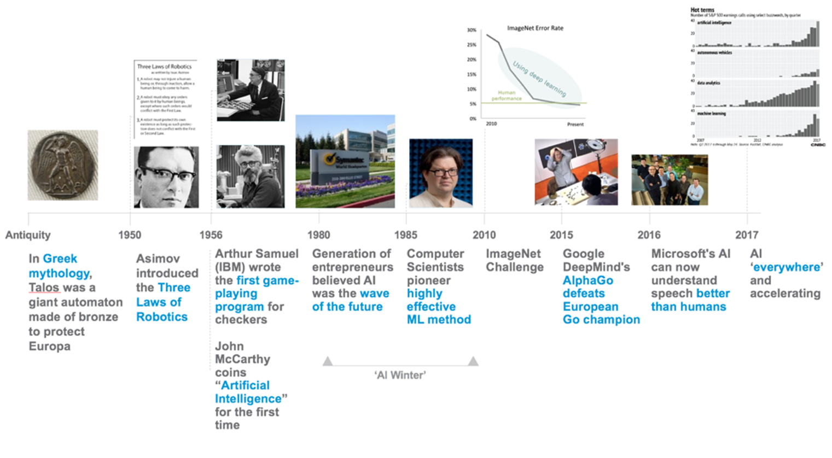
AI’s Developments
UTS :: FEIT :: Richard Xu
Image credit: VMware Xplorer Group

Slide 5
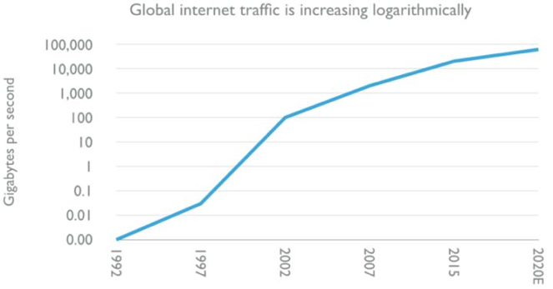
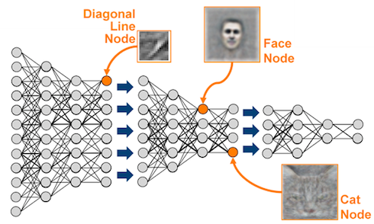
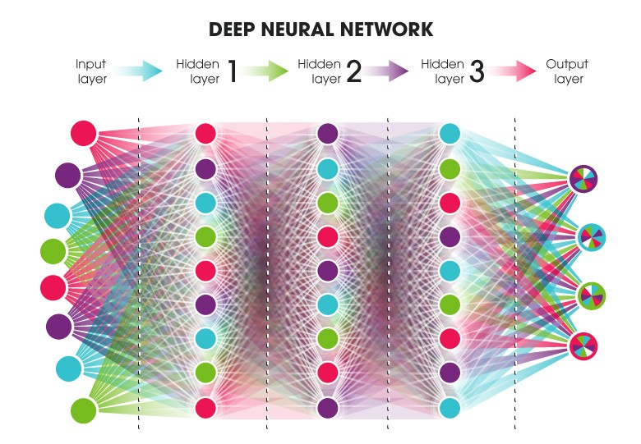
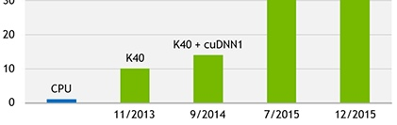
AI :why does it rise recently?
UTS :: FEIT :: Richard Xu
Huge amount of Data
Better algorithms
Much powerful GPU
Image credit: David Kelnar at Medium.com and NVIDIA

Slide 6
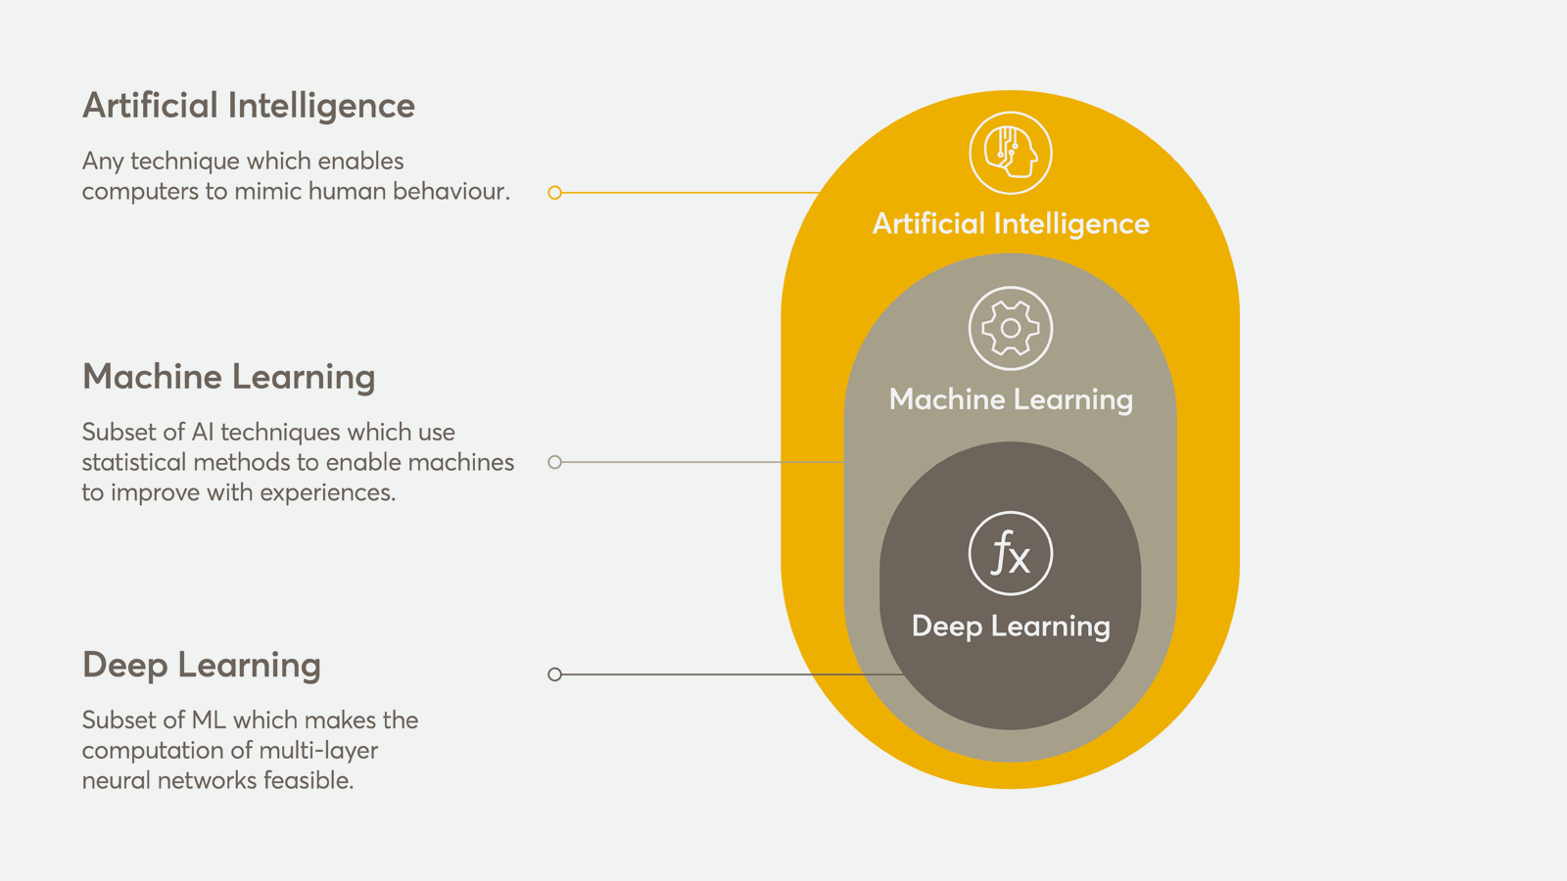
Buzzwords: AI, ML & DL
UTS :: FEIT :: Richard Xu
Image credit: NASTEL

Slide 7
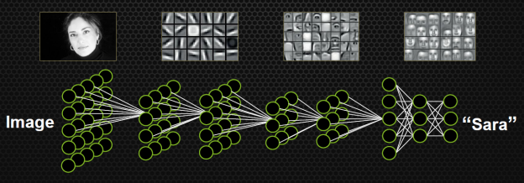
Convolutional Neural Network
UTS :: FEIT :: Richard Xu
More details are found on my Machine Learning notes:
https://github.com/roboticcam/machine-learning-notes/blob/master/cnn_beyond.pdf
Image credit: NVIDIA

Slide 8
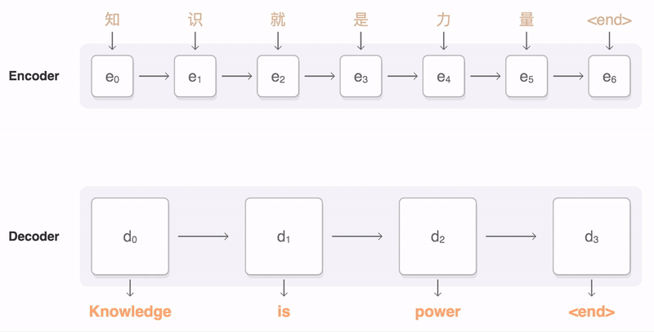
Recurrent Neural Network
UTS :: FEIT:: Richard Xu
Chinese
English
Image credit: Google Research

Slide 9
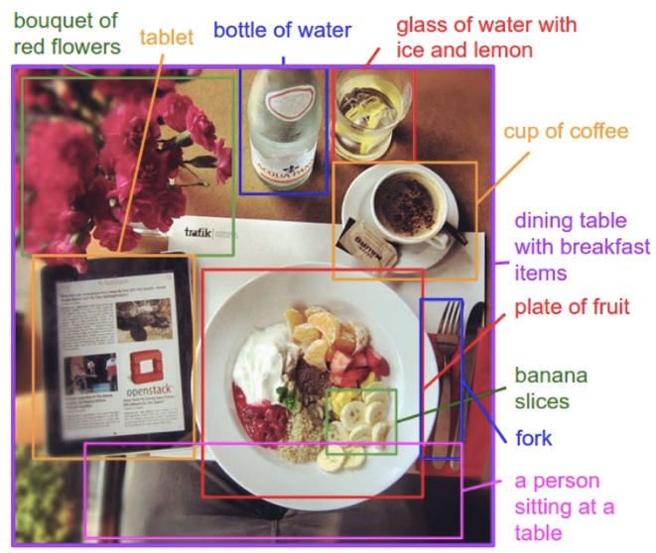
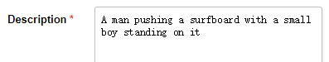


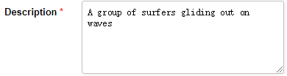

AI applications:
UTS :: FEIT :: Richard Xu
Present:
Stanford’s automated image part description generation
UTS’s work in text description to image
Future:
Image credit: Stanford vision lab
AI to create a full featured movie from a movie script

Slide 10
AI applications:
UTS :: FEIT :: Richard Xu
Present in NLP:
Washington Post’s robot reporter has published 850 articles in 2017
UTS::Deep Learning job advertisement generator
Salesforce’s AI research Seq2SQL: Generate Structured Queries from Natural Language using RL
UTS::DeepLearning NLP to OPAL query
Future in NLP:
Produce the world’s best selling ( in cryptocurrency ☺) novel

Slide 11


AI applications:
UTS :: FEIT :: Richard Xu
Present AI music:
SONY CSL Research Lab created first-ever entire songs composed by robot: Daddy's Car
Google’s AI song
Amy Bot (Richard’s lab Intern) – two hand’s piano play form left-hand play
-Left hand
-Left hand + Right hand
Future AI music:
AI compose a set of viral songs, i.e., AlanWalkerBot
All information stored in SQL
Produce the entire script

Slide 12
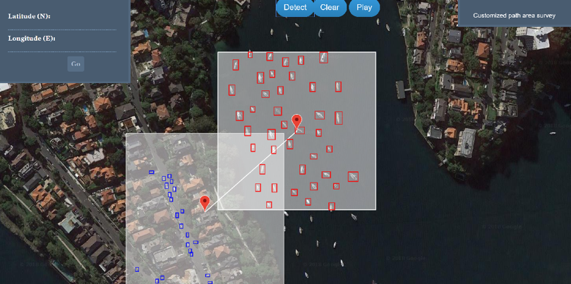
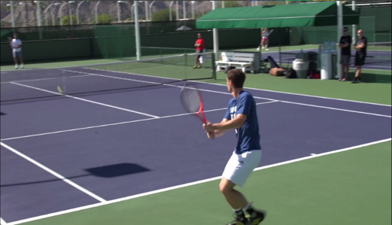
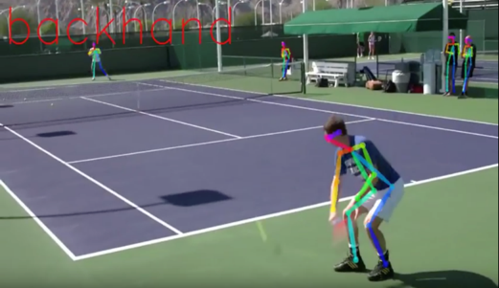
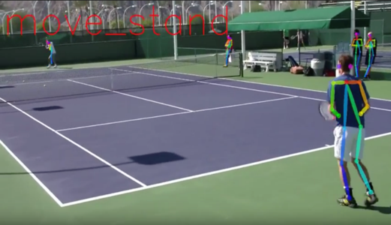
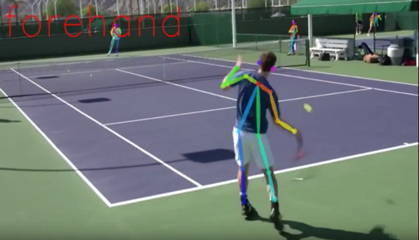
AI applications:
UTS :: FEIT :: Richard Xu
Present AI computer vision:
IBM Watson produced a trailer for Morgan by learning by feeding more than 100 horror film trailers
Adobe’s assisted paining robot
China’ AI giant SenseTime detect fashion landmarks and trend in millions of online cloth
UTS automated boat and car counting
Future AI computer vision:
UTS automated tennis stats collection (YouTube link)
Produce a full featured film

Slide 13
AI applications:
UTS :: FEIT :: Richard Xu
Present AI-powered defense:
UTS real-time strategy game for defense
Future AI-powered defense:
World will be in peace and harmony

Slide 14


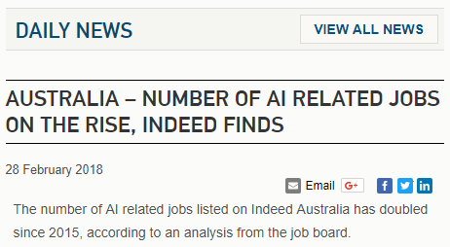
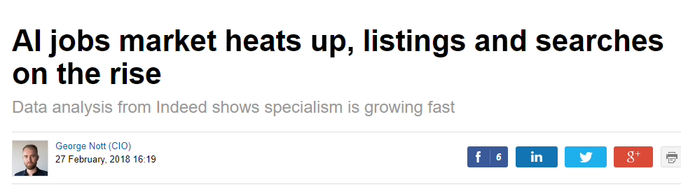

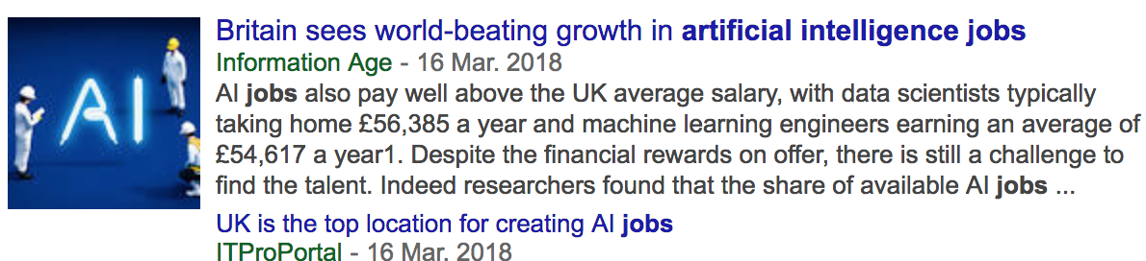
AI Talent hunting
UTS :: FEIT :: Richard Xu

Slide 15

UTS
Faculty of Engineering & IT
THANK YOU
Al will make the world better.

